Slide 1
Cool Roofs and Pavements Working Group Meeting
October 3rd, 2012
New Delhi, India

Slide 2
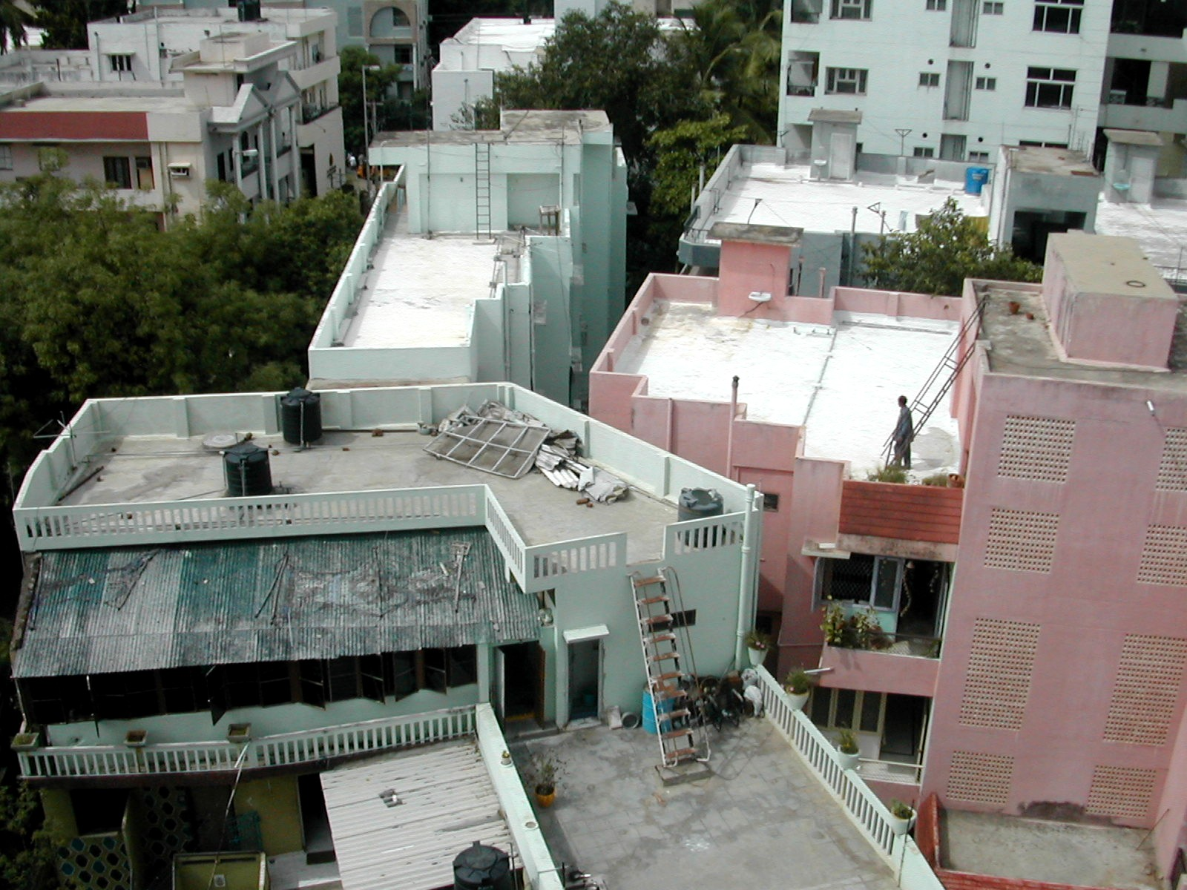
Welcome!
Agenda
Welcome and Introductions
Recap of September 2011 Working Group Meeting
Country Updates
Presentations on relevant cool roof topics
Discussion: Review of Priorities
Discussion: Planning for CEM4 in New Delhi

Slide 3
Welcome!
Agenda
Welcome and Introductions
Recap of September 2011 Working Group Meeting
Country Updates
Presentations on relevant cool roof topics
Discussion: Review of Priorities
Discussion: Planning for CEM4 in New Delhi

Slide 4
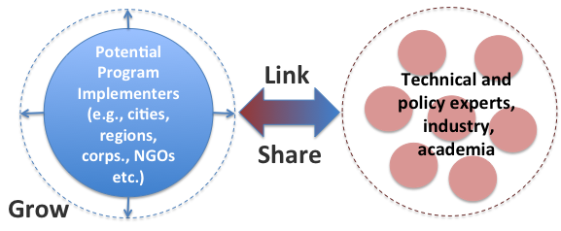
Global Cool Cities Alliance
The Global Cool Cities Alliance is dedicated to advancing policies and actions that increase the solar reflectance of our buildings and pavements as a cost-effective way to promote cool buildings, cool cities, and to mitigate the effects of climate change through global cooling.
4

Slide 5
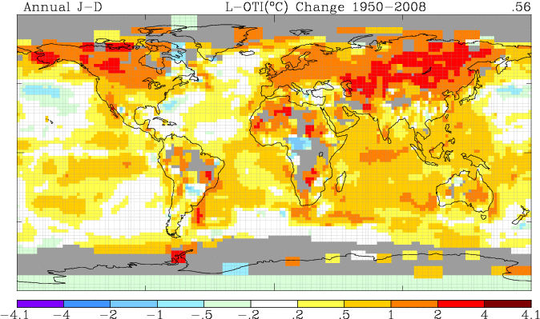
Rising Global Temperatures
Source: NASA

Slide 6
Especially in Cities, Thanks to the Urban Heat Island Effect
Urban Fabric above tree canopy
Human activity, combined with dark roofs and pavements, make cities hotter than surrounding rural areas.
Higher temperatures lead to greater energy use, lower air quality, and a reduced quality of life in urban areas.
Other
Pavements
Roofs
Vegetation
6
Notes:
Cities are warming at twice the rate, and urbanization is growing from 50% today to 80% by 2050.

Slide 7
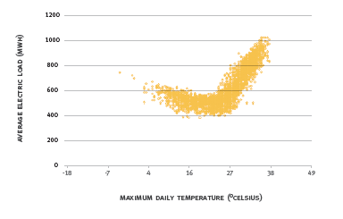
Electricity Load and Temperature
Adapted from Sailor, D. J. 2002. Urban Heat Islands, Opportunities and Challenges for Mitigation and Adaptation. Sample Electric Load Data for New Orleans, LA (NOPSI, 1995). North American Urban Heat Island Summit. Toronto, Canada. 1–4 May 2002. Data courtesy Entergy Corporation.
Notes:
This graph is from New Orleans but is common to most AC-dependent locations. At a particular threshold temperature, cities experience significant increases in electricity demand. This is often the most expensive, peak energy – and often the electricity that generates congestion (brownouts, blackouts, congestion pricing), and requires utility investments in peaking power supply. A similar chart for New York led the city to estimate that reducing their urban temperature by one degree would cut electricity use by nearly 500 million kWh and save them $100MM each year.

Slide 8
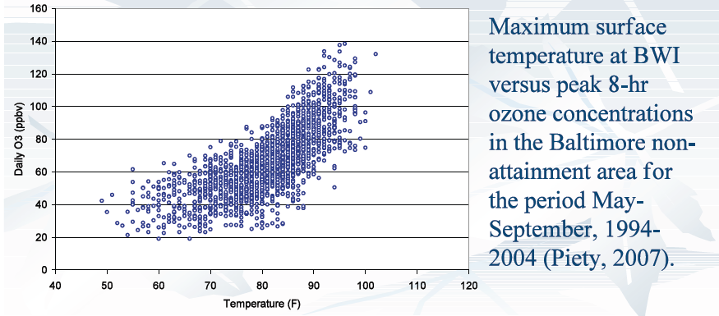
Smog Formation and Temperature
Transition Zone
EPA Compliance Std = 75
Source: Maryland Commission on Climate Change
Notes:
The impact of the heat island is also seen in smog formation. This chart is based on data taken from BWI airport just south of the Baltimore.
The formation of smog is highly sensitive to temperatures; the higher the temperature, the more likely smog will form. This is because the compounds that form smog do so by “cooking.” Reduce urban heat and those compounds don’t reach their cooking temperature. We tend to pursue a mitigation strategy that focuses on reducing smog-forming compounds, but we could be well served to also work to cool urban spaces.
I’ve alluded to this, but the estimated economic benefits in terms of energy efficiency and air quality improvements from greater reflectivity are eye-opening -- $10B per year.

Slide 9
New Air Conditioning Load: India
Millions of AC Units
Annual Growth: 14%
Source: World Bank

Slide 10
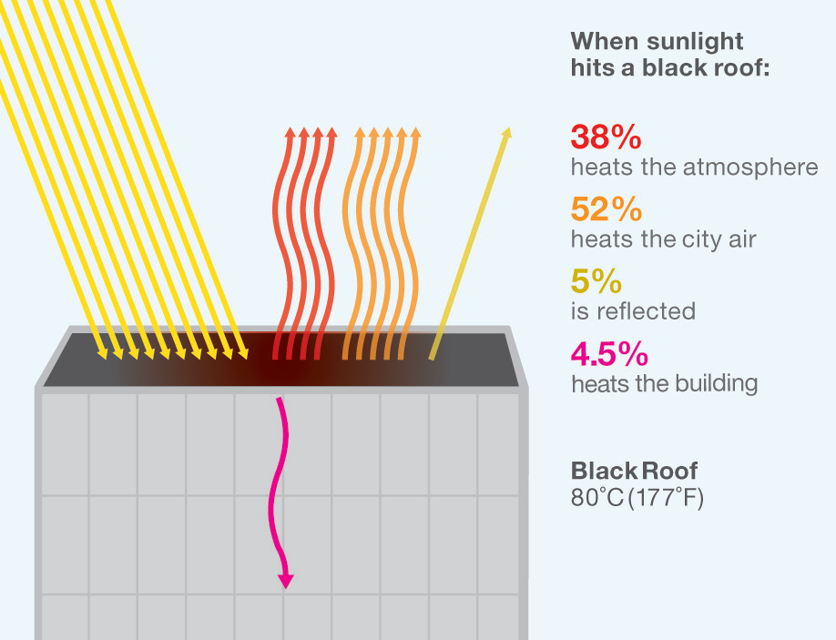
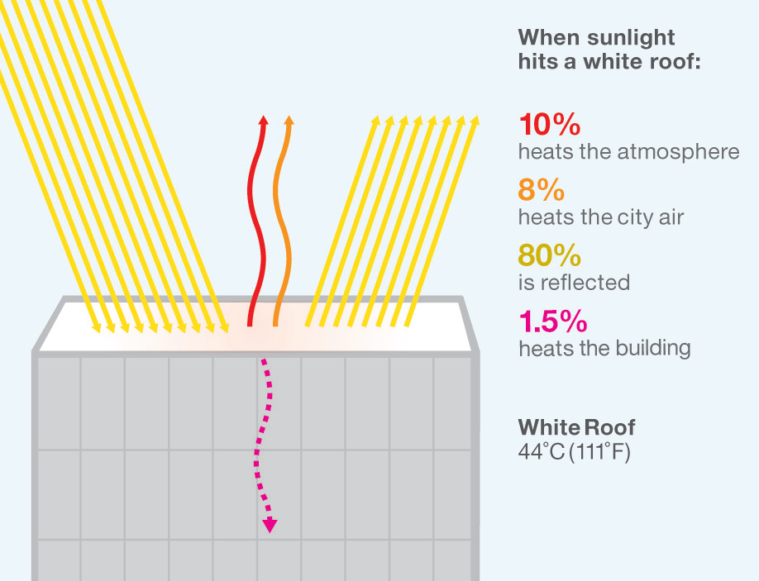
How Cool Roofs Work
Air Temperature 37°C (99°F)
Cool surfaces are measured by how much light they reflect (solar reflectance) and how long they hold heat (thermal emittance).
Notes:
A material’s coolness is a function of how much light it reflects (or its solar reflectivity) and how quickly it radiates away stored heat (or its thermal emissivity). Reflectivity is the more impactful variable in determining coolness. When sunlight hits a roof – or any surface – some of it is reflected back into the atmosphere as sunlight, some heats the atmosphere, and some is degraded into heat on the rooftop. Most of that heats the surface of the roof and is blown by wind to heat the surrounding area. Some also heats the building (the amount that heats the building also depends on the amount of insulation, if any).
White roofs have high solar reflectance and significantly reduce the amount of light energy converted to heat. As you can see on the right.
Here is a side by side picture of two roofs which are identical except for their color. A new white roof reflects about 70-80% of sunlight that hits it. As the roof ages and weathers, it will reflect about 55-65% of incoming sunlight – that is still 40-50% more sunlight reflected than a dark roof. At the same air temperature, a black roof will be approximately 36 degrees celsius hotter than a comparable white roof.

Slide 11
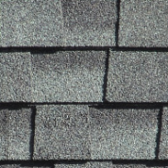
Cool Options Exist for Most Roofs
Asphalt Shingle (predominant residential roof type in U.S.)
Lasts 15-30 years
Cool Options: white or light grey shingles
Clay or Concrete Tiles (clay shown)
Lasts 30 – 50+ years
Cool Options: terracotta, cool colored pigment or white
Metal Roofs (often found on commercial, industrial and some low-income residential)
Lasts 20 – 50+ years
Cool Options: white/cool coated or painted metal (factory or on-site)
Built-Up Roof (multiple layers covered by ballast or smooth membrane)
Lasts 10 – 30 years
Cool Options: white gravel ballast or white smooth membrane
See Page 24 and 25 of the Cool Roofs and Pavements Toolkit for more details and examples

Slide 12
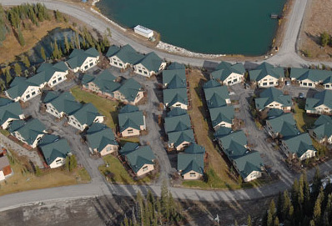
Cool, Reflective Colors
Cool color options exist to suit nearly any aesthetic requirement.

Slide 13
Benefits of Cool Surfaces
Building Scale
Up to 20% reductions in cooling demand on top floor.
Improved thermal comfort and productivity in unconditioned buildings (e.g., homes, warehouses etc.).
Urban Scale
Improved air quality – a $10 billion annual energy and health cost reduction opportunity in the U.S. alone.
Reduced peak electricity demand and avoided adoption of air conditioning.
Global Scale
Offset the warming effect of 24 gigatons of CO₂ – equivalent to taking 500 coal power plants offline for 20 years.
Every 10 square meters of white roof = 0.5 tons of CO₂ offset per year.
Longer lasting roofs.
Greater resiliency to heat events and climate change.

Slide 14
Global Superior Energy Performance Partnership (GSEP)
GSEP is one of 13 ongoing Clean Energy Ministerial (CEM) initiatives
GSEP objectives are to significantly cut global energy use by:
Encouraging industrial facilities and commercial buildings to pursue continuous improvements in energy efficiency
Promoting public‐private partnerships for cooperation on specific technologies or in individual energy-intensive sectors
Within GSEP there are six working groups
GSEP
ENERGY MANAGEMENT
WORKING GROUP
(Lead: U.S.)
POWER
WORKING GROUP
(Lead: Japan (P))
CHP
WORKING GROUP
(Lead: Finland)
STEEL
WORKING GROUP
(Lead: Japan)
COOL ROOFS
WORKING GROUP
(Lead: U.S.)
CEMENT
WORKING GROUP
(Lead: Japan)
Notes:
CEM
The Clean Energy Ministerial (CEM) is a high-level global forum established in 2010 to promote policies and programs that advance clean energy technology, to share lessons learned and best practices, and to encourage the transition to a global clean energy economy. Initiatives are based on areas of common interest among participating governments and other stakeholders.
Participating governments account for 80 percent of global greenhouse gas emissions and 90 percent of global clean energy investment. They also fund the vast majority of public research and development in clean energy technologies. They are the world’s leading installers of wind turbines and solar photovoltaics as well as the primary markets for emerging options such as carbon capture and storage. They are also the world’s major producers and purchasers of key energy-consuming products such as automobiles, televisions, and other appliances. The 23 governments participating in CEM initiatives are Australia, Brazil, Canada, China, Denmark, the European Commission, Finland, France, Germany, India, Indonesia, Italy, Japan, Korea, Mexico, Norway, Russia, South Africa, Spain, Sweden, the United Arab Emirates, the United Kingdom, and the United States.
GSEP
14 Countries involved: Japan and USA, Australia, Canada, Mexico, European Union, France, India, Korea, Russia, Finland, South Africa, Denmark, Sweden.
GSEP objectives are to significantly cut global energy use by:
Encouraging industrial facilities and commercial buildings to pursue continuous improvements in energy efficiency
Promoting public‐private partnerships for cooperation on specific technologies or in individual energy-intensive sectors
Within GSEP there are six working groups

Slide 15
Cool Roofs and Pavements Working Group
First met in September, 2011.
Four official members – India, Japan, Mexico, and the U.S.
Participation from Brazil and South Africa
Working Group governments represent 8 of the 20 largest cities.
Robust participation from industry, NGOs, and technical experts
The Cool Roofs and Pavements Working Group aims to accelerate the development and deployment of cool roofs, pavements and other cool surfaces to improve building efficiency and comfort, reduce urban heat, and reduce global warming

Slide 16
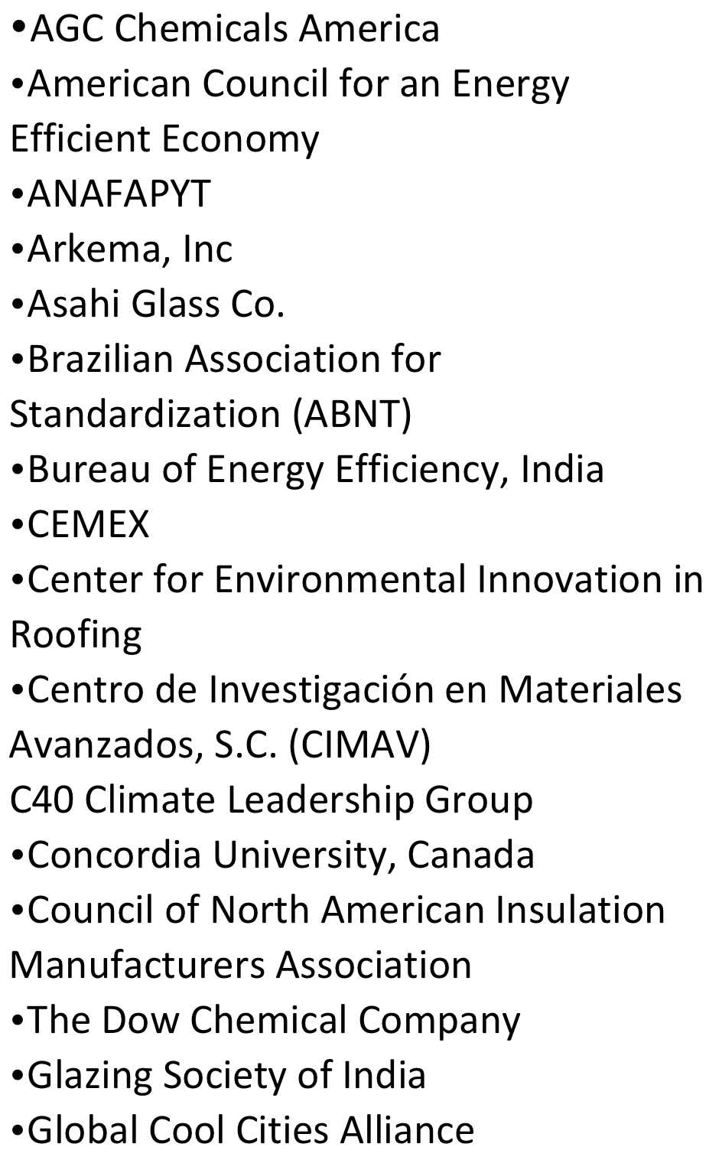
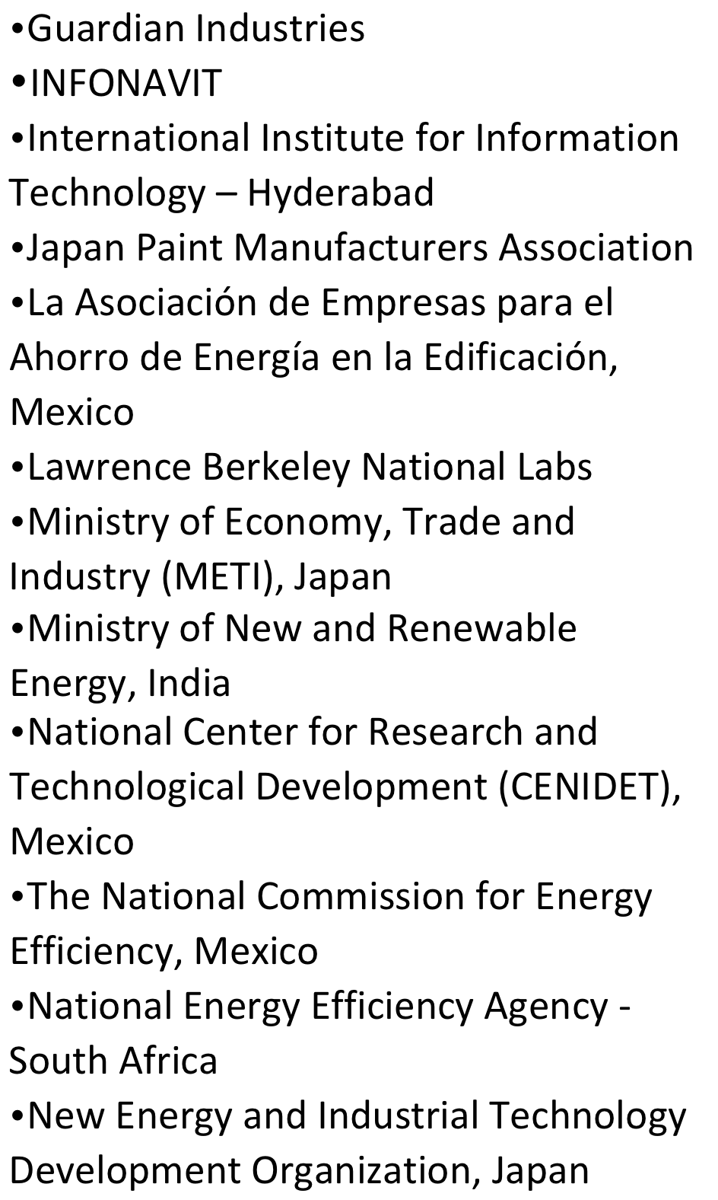
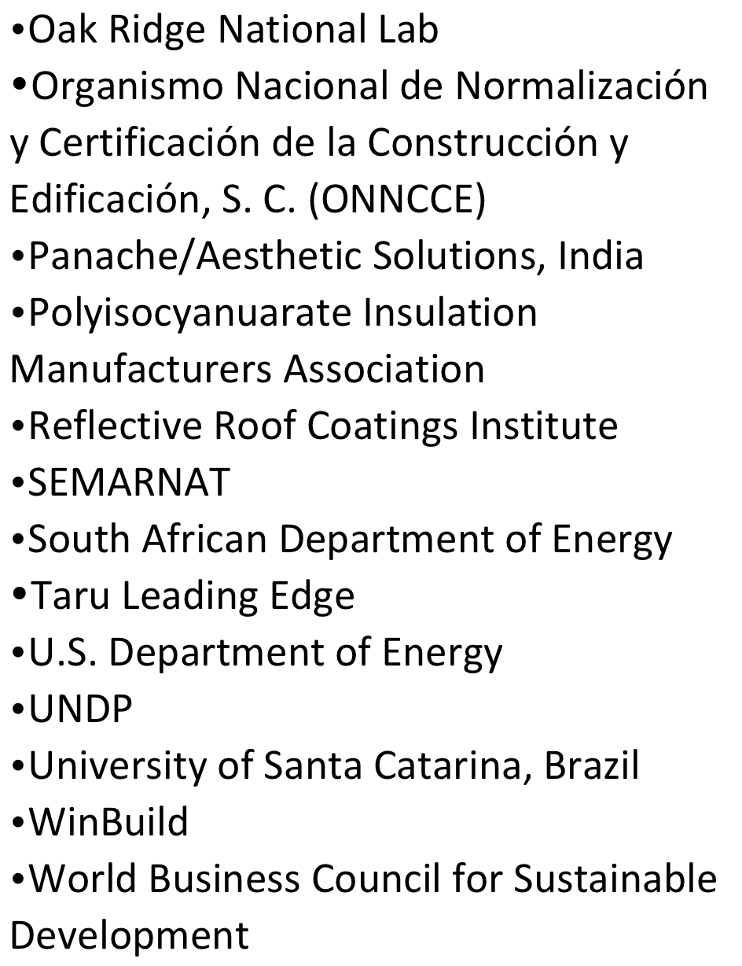
Participants

Slide 17
Working Group Objectives/Activities
Collect information and tools of existing working group partners in an accessible repository. Draft case studies and identify best practices of cool roof and pavement development efforts.
Promote cool roofs and pavements and identify or develop local champions to drive development and implementation.
Develop projects with partners to demonstrate the efficacy of cool roofs and pavements.
Provide technical assistance to develop code infrastructure.

Slide 18
Three Themes Emerged
Affordable Housing
Cool Pavements
Product Testing, Rating, and Labeling – i.e., “code infrastructure”
Notes:
Common threads amongst countries
Explain focus of working group (and collaborations with building envelope community)

Slide 19
Progress on Objectives
Objective: Collect information and tools of existing working group partners in an accessible repository.
Launched the Cool Roofs and Pavements Toolkit and Knowledge Base.
Over 500 entries, 3,300 unique visitors since May 2012
Gathered codes, laws, best practices, and case studies from WG countries and beyond.
www.CoolRoofToolkit.org

Slide 20
Progress on Objectives
Objective: Promote cool surfaces and identify or develop local champions to drive development and implementation
Presented on Working Group in Sao Paulo, Mexico City, Washington DC, Paris (IEA), roofing industry events, and more.
GCCA partnerships with C40 Climate Leadership Group (68 global cities) and R20: Regions of Climate Action (30+ states/regions) provide pool of interested local partners.

Slide 21
Progress on Objectives
Objective: Develop projects with partners to demonstrate the efficacy of cool roofs and pavements.
Pilot project underway in India – affordable housing
Pilot projects being planned in Mexico – affordable housing, commercial buildings etc.

Slide 22
Progress on Objectives
Objective: Provide technical assistance to develop code infrastructure.
Launch of SUCCEED in India
Mexico
Cool Codes Collaborative
Notes:
SUCCEED launching tomorrow to help develop markets, train workforce, and provide product testing and rating
Mexico – arranging technical capacity interactions
US Cool Codes Collaborative – a loosely affiliated group of US groups that have developed model codes and proposals for cool surfaces (both clarifying definitions and greater stringency) for international standards (ASHRAE, IGCC), some state codes, and green building ratings systems.

Slide 23
Agenda
Welcome and Introductions
Recap of September 2011 Working Group Meeting
Country Updates
Presentations on relevant cool roof topics
Discussion: Review of Priorities
Discussion: Planning for CEM4 in New Delhi

Slide 24
Afternoon Discussions
Discussion #1: How do we build on what we are doing already? Are there new areas we should explore?
Discussion #2: What should we do together in 2013? How do we communicate more broadly about our efforts?
Discussion #3: Working Group operations – are you getting out of the Working Group what you need? What changes would make it more effective and useful?

Slide 25
Agenda
Welcome and Introductions
Recap of September 2011 Working Group Meeting
Country Updates
Presentations on relevant cool roof topics
Discussion: Review of Priorities
Discussion: Planning for CEM4 in New Delhi

Slide 26
New Cool Roof Research Presentations
Presentation #1: Climate and Building Benefits of Cool Surfaces
Dr. Vishal Garg, Ms. Jalpa Gandhi, Mr. Ratish Arumugam
International Institute of Information Technology – Hyderabad
Presentation #2: Results of a Cool Roof Pilot Project on Affordable Houses in Sanand, Gujarat
Mr. Saumyaranjan Sahoo
Center for Environmental Planning and Technology (CEPT University)

Slide 27
Agenda
Welcome and Introductions
Recap of September 2011 Working Group Meeting
Country Updates
Presentations on relevant cool roof topics
Discussion: Review of Priorities
Discussion: Planning for CEM4 in New Delhi

Slide 28
Discussion #1
Working Group Focus Issues
Are current WG issue areas still priorities?
Are there new issue areas that interest WG members?
Are these priorities a fit for the WG?
Notes:
Bilateral approach
Shared projects? Affordable housing
Do you want to do more collaborative work or one-on one?

Slide 29
Agenda
Welcome and Introductions
Recap of September 2011 Working Group Meeting
Country Updates
Presentations on relevant cool roof topics
Discussion: Review of Priorities
Discussion: Planning for CEM4 in New Delhi

Slide 30
Discussion #2
2013 Planning
What are the major 2012 accomplishments that we want to share?
How can we grow our 2012 activities in 2013? Are there new initiatives/partnerships?
How do we want to communicate our activities to a broader audience?
What specific commitments can be made at CEM4?
What are the next steps and deadlines for deliverables for CEM4?
Notes:
Graham/Graziella – what is “announceable”?
Communicating to a higher level audience? Roundtable, joint statement? Statements from govts (invest $X by 2014 etc.) – can we create that message and work within the governments to announce this. How to position so that ministers announce them?
Could do a roundtable at the CEM? Deadline for topics is Oct 5th Prepare what we need from each country…funding etc.

Slide 31
Discussion #3
Getting the Most Out of the Working Group
Did you utilize WG resources/contacts over the past year? If not, what was the obstacle?
How can we use the WG to support your priorities?
How can the private sector and civil society support your priorities?
Notes:
What do you need this to be to be an active participant?
What is working? What isn’t? How can we communicate better? How frequently
How can we structure private sector engagement

